Slide 1

Fractal Image Compression Anton Brucherseifer Sarah Moy de Vitry Daniel Peter Michael Seeber
TexPoint fonts used in EMF.
Read the TexPoint manual before you delete this box.: AAAAA
Notes:
We worked on fractal image compression, but not only improved performance but also added extension to it.
Time: 13 seconds
Total: 00:13
18

Slide 2


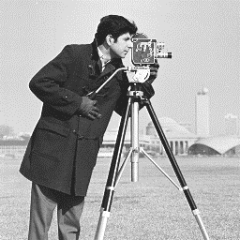


Lossy Image Compression
FIC
DECOMPRESS
Notes:
What is the fractal image compression about?
Natural image representation: store grayscale value for each pixel -> large amount of memory required (1 byte per pixel)
The Image can be compressed using FIC which gives a compressed file that is much smaller.
One thing to note: Fractal Image compression is a asymmetric compression method, which means that compress is magnidues slower than decompression → reason for this will become clear in a minute.
We focused on the «slow» part.
This picture is 256x256, the compression ratio is 6.5
Time: 50 seconds
Absolute:

Slide 3
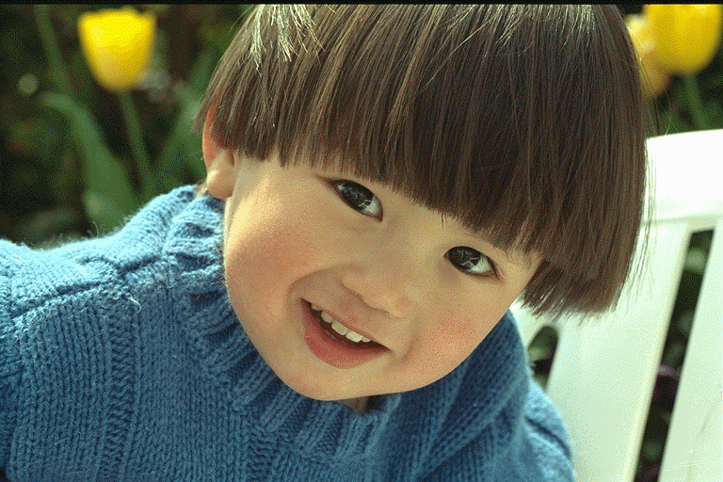
Self-Similarity
Notes:
How does FIC compress?
The algorithm tries to find patches that look similar. In case of natural photos, there are often some similar blocks
Time: 51 seconds
Absolute:

Slide 4

FIC Algorithm
rotate₂₇₀ (flip( ))
$$\text{≈} contrast ∗ + brightness$$
Notes:
Some more implementation details on our algorithm:
Rescale a copy of the image to half the size
Split original image and small copy into blocks
Represent orginial blocks using the self similarities: find a similar looking block from the copy. We allow the blocks from the copy to be transformed using scalar contrast and brightness values. The contrast and brightness values that lead to the closest fit are computed by solving a least squares problem.
Allowing the transformations to additionally include rotations and flips, you may find better similarities
We save for each block of the original image the transformation that leads to the best similarity. Transformation = index of block in copy, contrast (scalar), brightness (scalar), which rotation, which flip
Time: 1:02 minutes
Absolute:

Slide 5
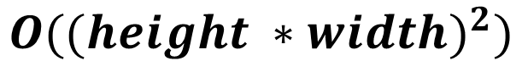
FIC Algorithm
For each pair of blocks:
Find the transformation that results in the highest similarity
$$O(({height ∗width)}^{2})$$
Notes:
So for our FIC algorithm the asymptotic runtime complexity is O(n^4), the high level idea behind is that we have 2 sets of blocks (size = height*width) which we need to compare to each other.
For our project, this means that we have some parts in code that are run many times over and over (nested loop). We thus have some parts that are extremely performance critical.
Time: 29 seconds
Absolute:

Slide 6


Baseline Implementation
https://github.com/mannyray/fractalMapping
Rewrote OO-code to C-style code
Bugfix: Rotations
Added: Flips
Notes:
We started off from the C++ code from a GitHub repo
First, be rewrote OO-code to C code.
We also fixed a bug in the function that rotates an image by 90°, (he did a transposition)
Later on we also added «flips» as additional transformation to improve the quality
Time: 49 seconds
Absolute:

Slide 7
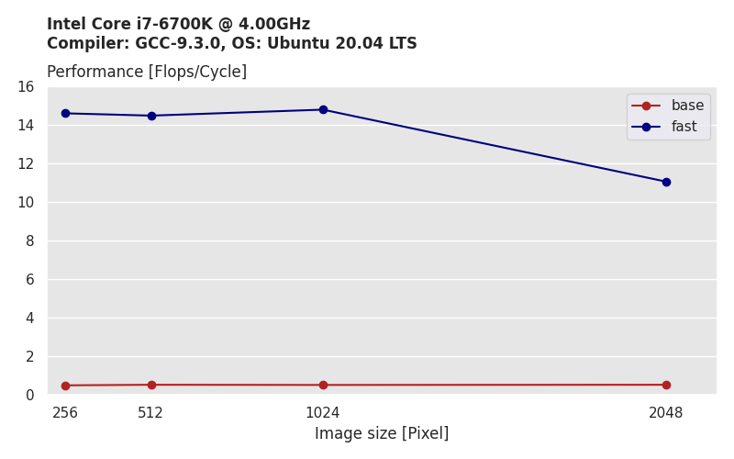
Compress Performance
Notes:
For all the plots that follow we always compiled with the following flags: -O3 –ffast-math –march=native –funroll-loops
This plot shows the performance of the base implementations compared to our fast and optimized algorithm.

Slide 8
Compress Performance
28x
Notes:
For an image size of 1024 this gives a speedup of 28x.
Exact: 14.81 / 0.52 = 28.48

Slide 9
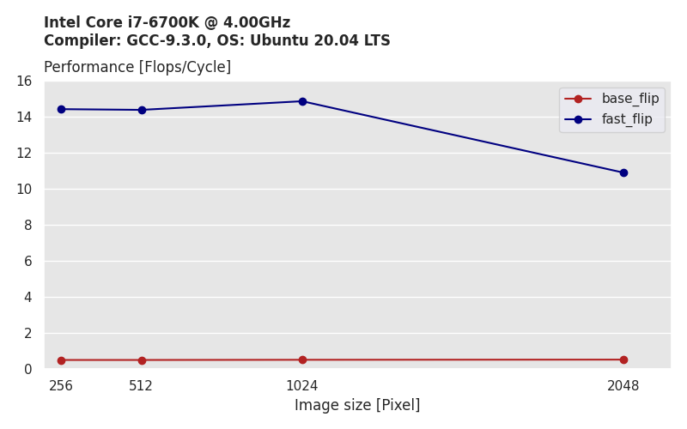
Compress Performance with Flip
29x
Notes:
This performance plot includes the flip transformation. The performance difference is very subtle, when additional transformations are added.
The base implementation has more floating point operations, no we not only increased performance but also decreased the amount of flops.
Exact: 14.88 / 0.52 = 28.61

Slide 10
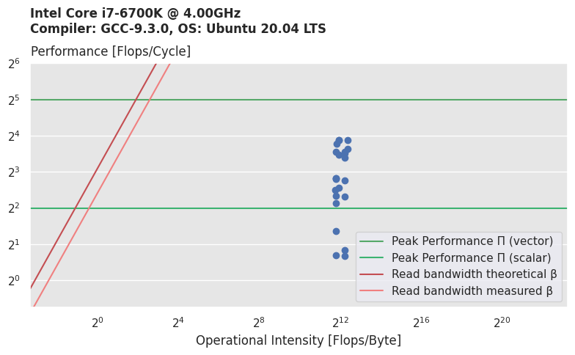
Roofline Plot of our Optimizations
Notes:
In this roofline plot is for a image size of 512x512 and you can see all the different functions (flip and noflip) we created. For this image size the program is a compute bound.
Time: 26 seconds
Absolute:

Slide 11
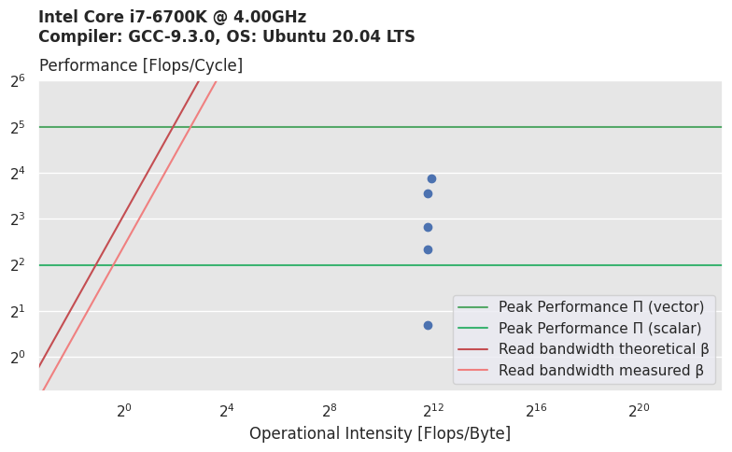
Roofline Plot without Flip
AVX
ILP
inline
scalar replacement
unoptimized
Notes:
Time: 36 seconds
Absolute:

Slide 12

Roofline Plot with Flip
AVX
ILP
inline
scalar replacement
unoptimized
Notes:
Time: 12 seconds
Absolute:

Slide 13
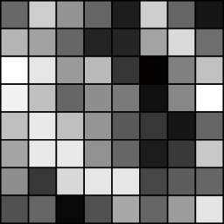
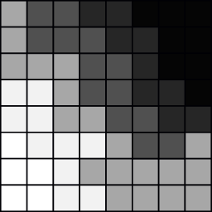
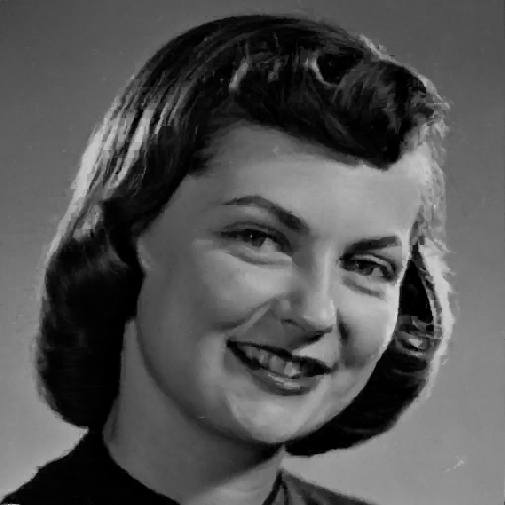

Entropy Based Search Space Reduction
High entropy
Low entropy
→ unlikely similarity
→ likely similarity
→ low reusability
→ high reusability
Unoptimized
2.2263 s
Reduction: 80 %
0.4596 s
4.84x speedup
Notes:
1.) General idea: compute entropy across all blocks, discard blocks that are less likely to be used
2.) Loss of detail, but often not noticeable
Image: 512x512
Note: because of the hand-wavy nature of image compression we accept non-identical results as long as they are visually acceptable
Time: 1:24 minutes
Absolute:

Slide 14
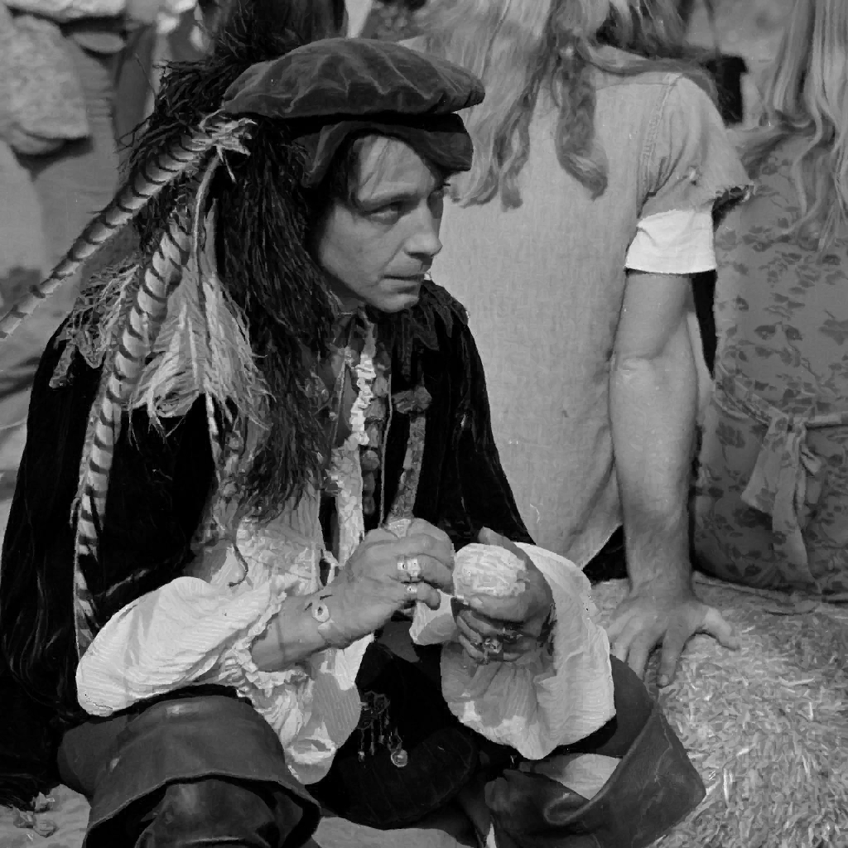
Results:
1024 x 1024 pixels
Base implementation: 228s
Fast unoptimized: 40s
Fast optimized: 3.04s
Fast optimized
w/entropy: 0.59s
386x Speedup
Notes:
With flip, resulting image
Base: github implementation
Fast unoptimized: write from scratch, no constraints
Fast optimized: Implemented all the improvements we learned in the course
Fast optimized w/ entropy: using 80% entropy reduction on top
Time: 1:41 minutes
Absolute:

Slide 15
Strides
So far: stride = 16
Notes:
Time: 23 seconds
Absolute:

Slide 16
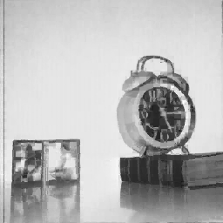
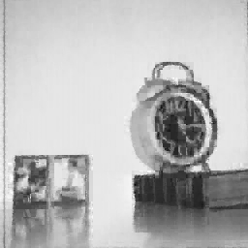

Strides
Stride = 2
Stride = 16
Stride = 32
0.75 s
0.03 s
0.01 s
Notes:
Smaller strides can improve the quality for small images
Time: 41 seconds
Absolute:

Slide 17


Strides
Stride = 16
Stride = 64
3.04 s
0.21 s
Notes:
Larger strides can improve the runtime for large images
Time: 20 seconds
Absolute:

Slide 18

Discussion

Slide 19
Backup Slides
Cost Analysis
Decompression
Validation of flip and rotations

Slide 20
Cost Analysis
Straight-forward C implementation (without flip)
C(n) = (adds(n) + muls(n), divs(n), sqrt(n)) = (n⁴ / 4, n⁴ / 1024, n⁴ /4096)
C(n) = flops(n) ≈ n⁴ / 4
Notes:
With flip is more or less double the numbers

Slide 21

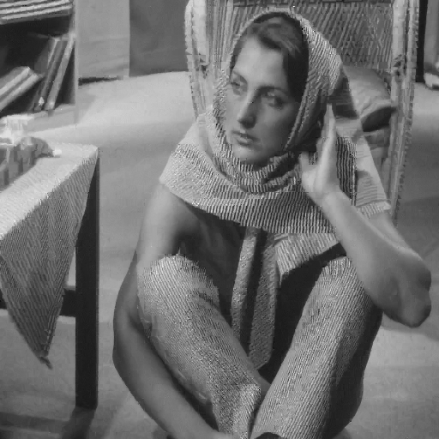
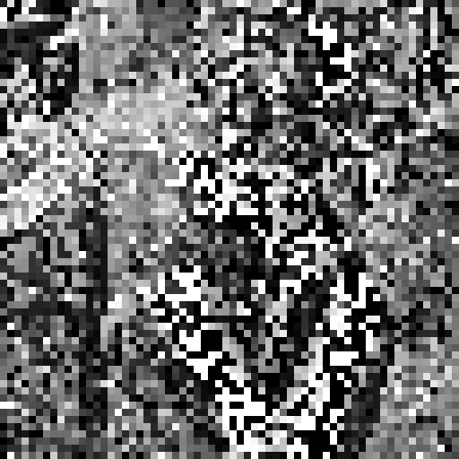
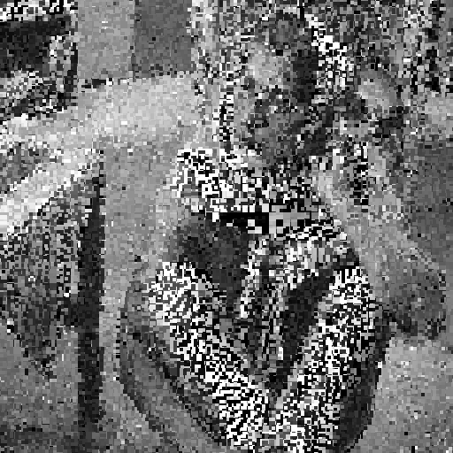
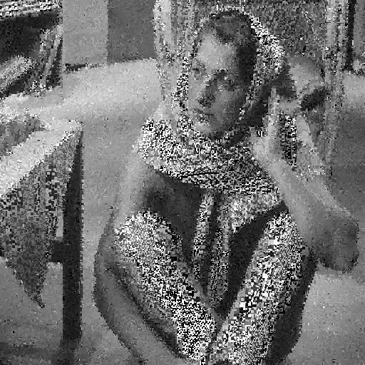


Decompression

Slide 22
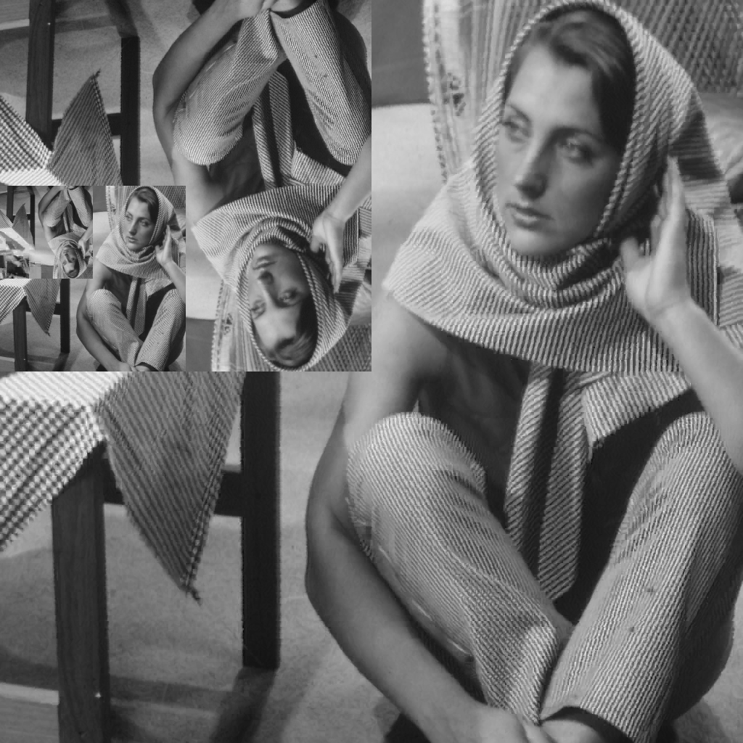

Validation of flip and rotations

